Slide 1

MITRE Overview

Slide 2

MITRE: Established to Serve the Public Interest
Notes:
MITRE is a not-for-profit company chartered in 1958 to work solely in the public interest.
Among a number of companies established in the late 1940s and 1950s to bring public sector resources in science and technology to work for govt. in an independent, conflict-free environment.
This led to the establishment of an ecosystem of federal research centers.
RAND, the Lincoln Lab, Aerospace, and the National Labs are among the 40 federally funded research and development centers that exist today.
At present, MITRE only operates federally funded research and development centers.

Slide 3

MITRE Manages Seven Federally Funded Research and Development Centers (FFRDCs)
Notes:
Today we operate seven FFRDCs. This puts MITRE in a unique position to serve as a bridge among agencies, facilitating collaboration and sharing common solutions broadly.
National Security Engineering Center
NSEC helps the government make choices based on objective technical assessments, mission requirements, and budgetary constraints. We also transfer the prototypes or system improvements that our own staff develops either directly to our sponsors or to commercial companies for production.
Center for Advanced Aviation System Development
CAASD provides the FAA with advanced technical capabilities in systems engineering, mathematics, and computer science. We also apply in-depth domain knowledge in air traffic management and airspace user operations relevant to the National Airspace System (NAS) as well as international aviation.
Center for Enterprise Modernization
CEM, sponsored by the Internal Revenue Service and co-sponsored by the Department of Veterans Affairs, takes on the challenge of reshaping and modernizing the technology infrastructure as well as mission-critical business and management functions of civilian federal government agencies.
Homeland Security Systems Engineering and Development Institute
HS SEDI helps the Department of Homeland Security improve its performance in critical functions, such as acquisition processes, risk and program management, information technology engineering, and decision-making capabilities.
Judiciary Engineering and Modernization Center
JEMC provides objective assessments of the technical challenges the judiciary faces, analyzing the impact and risks of both available and emerging systems.
CMS Alliance to Modernize Healthcare
CAMH works across the health community on a range of business, policy, technology, and operational challenges.
National Cybersecurity Center of Excellence
The National Cybersecurity Center of Excellence is the first FFRDC solely dedicated to enhancing the security of the nation’s information systems.

Slide 4

Our Employees
Notes:
Total number of employees – 7,300
· Average years of experience – 25
· Average tenure with MITRE – 12
· Percentage of employees with advanced degrees – 67% with masters degrees; 12% with doctorates

Slide 5
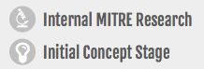
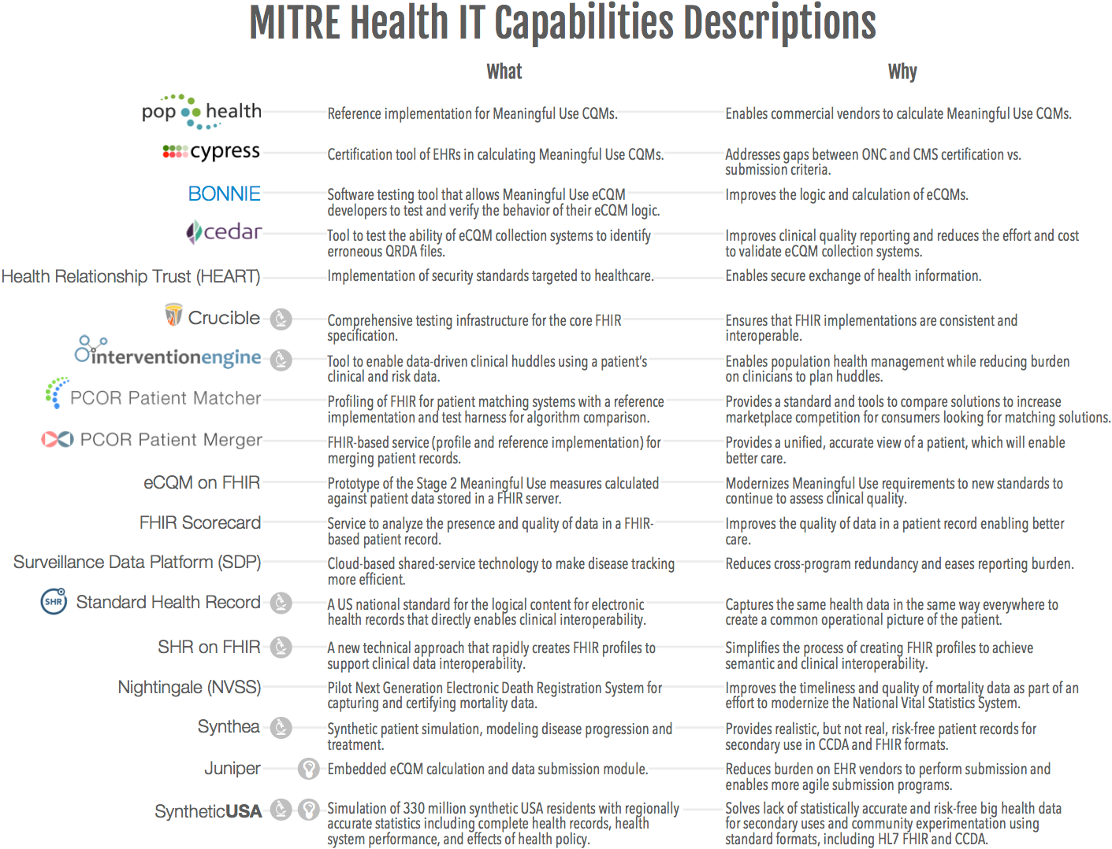

Slide 6
MITRE Data Interoperability Examples
Aviation Safety Information Analysis and Sharing (ASIAS)
Data analytics infrastructure and collaboration across all major air carriers supporting safety analysis and information sharing
CDC Surveillance Data Platform
Infrastructure for reporting critical public health data to make disease tracking more efﬁcient through the use of cloud-based technology
Common Vulnerabilities and Exposures
Common identifiers and registry for publicly known cybersecurity vulnerabilities
Cursor on Target
A simple exchange standard for sharing “what”, “where”, and “when” information about targets focused on shared situational awareness
Clinical Quality Language
Specification for the expression of clinical knowledge harmonizing the Clinical Decision Support (CDS) and Clinical Quality Measurement (CQM) domains
hData and HL7 FHIR
hData was the first lightweight, web-based, RESTful standard for health data exchange
Quality Data Model (QDM)
An information model defining relationships between patients and clinical concepts for electronic quality performance measurement
The National Information Exchange Model (NIEM)
Common vocabulary that enables efficient information exchange across diverse public and private organizations
OpenII
An open-source platform for information integration tools supporting efficient schema mapping

Slide 7



MITRE’s Data Engineering Capability
MITRE’s core data expertise
The entire data supply chain, including data provenance, collection, loading, transformation, extraction, normalization, integration, cleansing, and data management platform design, as well as strategies for migrating data into cloud, and database consolidation. Specific capabilities include:
Large scale data management
Information engineering
Data modeling and standards
Data integration and fusion
Data quality
Performance tuning/optimization, sizing and scaling
Data provenance and metadata

Slide 8

Bringing Data Expertise to Healthcare
http://standardhealthrecord.org
The backdrop:
A costly healthcare system
High levels of waste, fraud, medical errors
Proprietary control of patient data in numerous information silos
The key problem: Today’s healthcare systems do not capture the same information in the same way, and consequently, cannot easily share or merge information from different sources to create a common operational picture of a patient across multiple care locations and contexts.
The solution: A US national standard for the logical content for electronic health records: the Standard Health Record (SHR)

Slide 9
Oncology Data Challenges
Clinical trial data is high value, but only 3% of cancer patients enroll in clinical trials
Tremendous untapped value in clinical treatment data
Existing clinical treatment data do not inform evidence-based and data-driven treatment of cancer patients
Low quality, poorly coded, unstructured
Not harmonized with clinical trial data elements
Difficult to link population health and other real world data sources to research data
National Death Index
National Health Interview Survey
Cancer Registries, etc.

Slide 10
Metastatic Breast Cancer Patient
Metastatic Breast Cancer
Biopsy
Biopsy
2011
2012
2013
2014
2015
Treatment 1
Treatment 2
Treatment3
Treatment 4
ER+ / PR+ / HER2-
ESR1 WT
RB1 WT
PTEN WT
CDH1 nonsense + LOH
ER- / PR- / HER2-
ESR1 single-copy deletion
RB1 nonsense + LOH
PTEN homozygous deletion
CDH1 nonsense + LOH
Clonal Evolution
and
Selective Pressure

Slide 11
Data Environment
Oncology
Non-Oncology
Registries
Statistics
Surveys
Treatment Data
Clinical Trial Data
Population Data
Distributed
Broad Scope
Shallow Detail
Low Quality
Not Standard
Distributed
Narrow Scope
Deep Detail
High Quality
Standardized
Distributed
Broad Scope
Aggregated
Semi-Standard
Biologic Basis of the Cancer Process

Slide 12
Proposal: Standardization and Capture of Oncology Treatment Data
Goal: Standardize and support the collection of better treatment data, linking clinical trial and population data to inform the optimal treatment for cancer.
Standardize treatment data to support oncology
Curate longitudinal health data for 3 patients
Build a prototype to capture standardized treatment data
Build a prototype to link treatment and population data to enable analytics
SHR Core evolution and maintenance

Slide 13










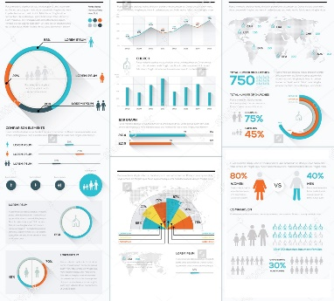



MITRE Prototypes
Task 2: Curate Patient Records
Task 3: Data Capture Prototype
Task 4: Aggregation Prototype
Other
Providers
Clinical
Trials
Population
Data
Patients
Beacon
Curate
Aggregation Prototype
Visualize
Data Capture Prototype
Structured Oncology
Treatment Data
Clinical pilot
Providers
Patients
Data Standardization (Tasks 1 and 5)

Slide 14
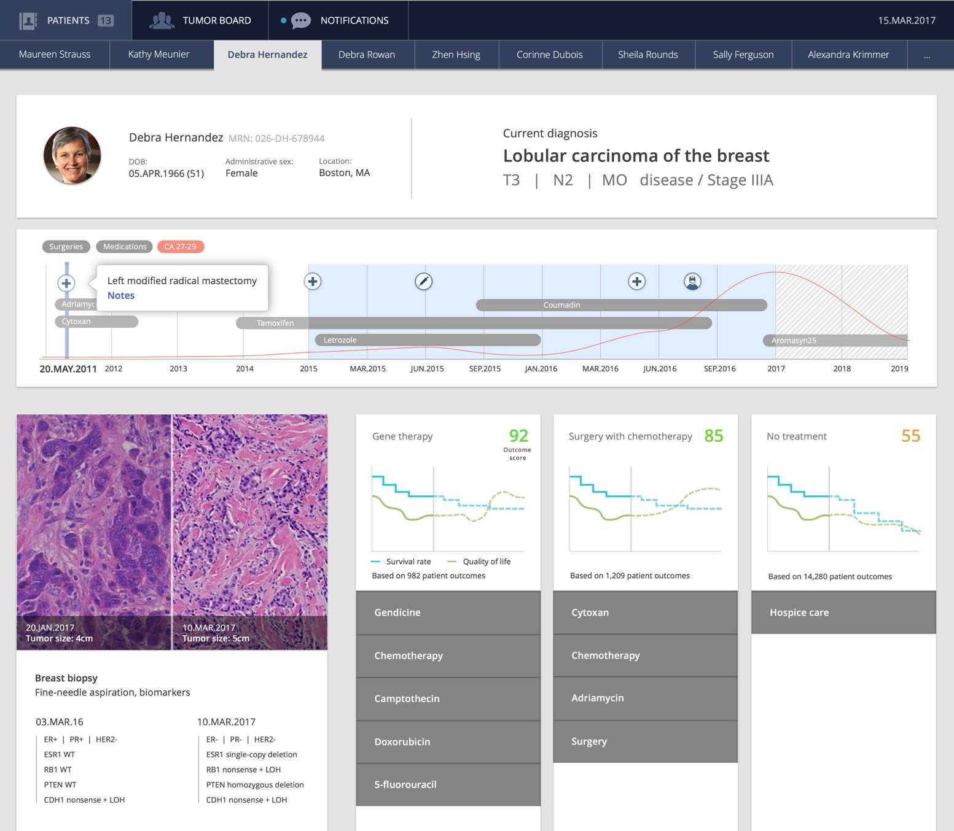
Task 2: Conceptual Mockup

Slide 15
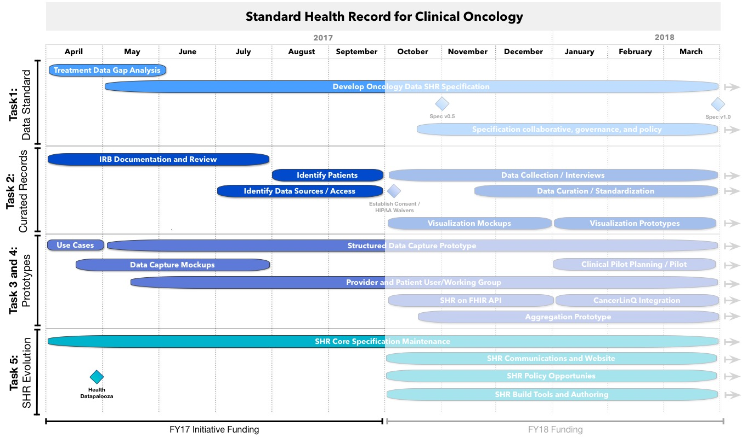
Timeline

Slide 16
SHR for Clinical Oncology Elements
Priority data elements - initial focus on breast cancer
Current Staging
Using American Joint Committee on Cancer (AJCC) Tumor, Node, Metastasis (TMN) Staging
Pathology results
Initial diagnosis of an invasive cancer (Breast)
For treatment plan, the histological grade assessment (e.g., HG1, HG2, or HG3) and the status of the three most important receptors (estrogen receptor, progesterone receptor, HER2)
Oncotype DX Recurrence Score
A proprietary test of Genomic Health currently scanned into medical records
Genetic tests for BRCA genes and gene panels
Best overall response
Using a standardized criterion such as RECIST.
Includes complete response, partial response, stable disease, or progressive disease
Target versus non-target lesion assessment
Radiology assessment and classification of response as partial response to stable disease
Risk factors
Includes general health history, smoking, pregnancies, age at first menses, family history of cancer
Usually collected but not not in structured form and non-comprehensive
Toxicity assessment
Event dates
Precise dates of diagnosis and recurrence (with methodology) are not precisely defined nor captured on medical records

